Slide 1
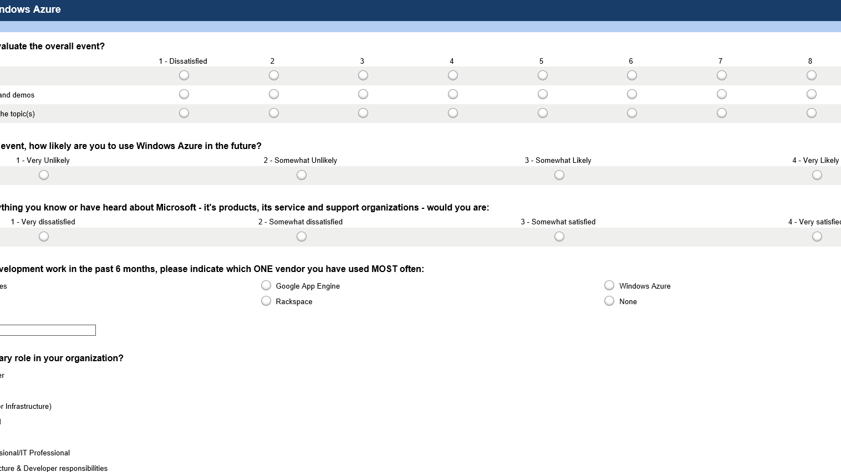
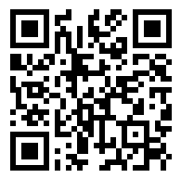
Take the DevUnleashed Windows Azure Survey
Your feedback, helps us make these events available to your community, please fill it out sometime today.
www.surveymonkey.com/s/azureunleashed

